Slide 1
OIL PAINTING FILTER
Team: LARA IBRAHIM & ZAHRAA TARHINI
Instructor: DR. M AOUDE

Slide 2
MOTIVATION & CONTEXT
Real-world image/video processing
Oil painting filter is computationally heavy
Sequential processing too slow for many frames
Goal: Parallelize to reduce runtime while preserving output quality

Slide 3
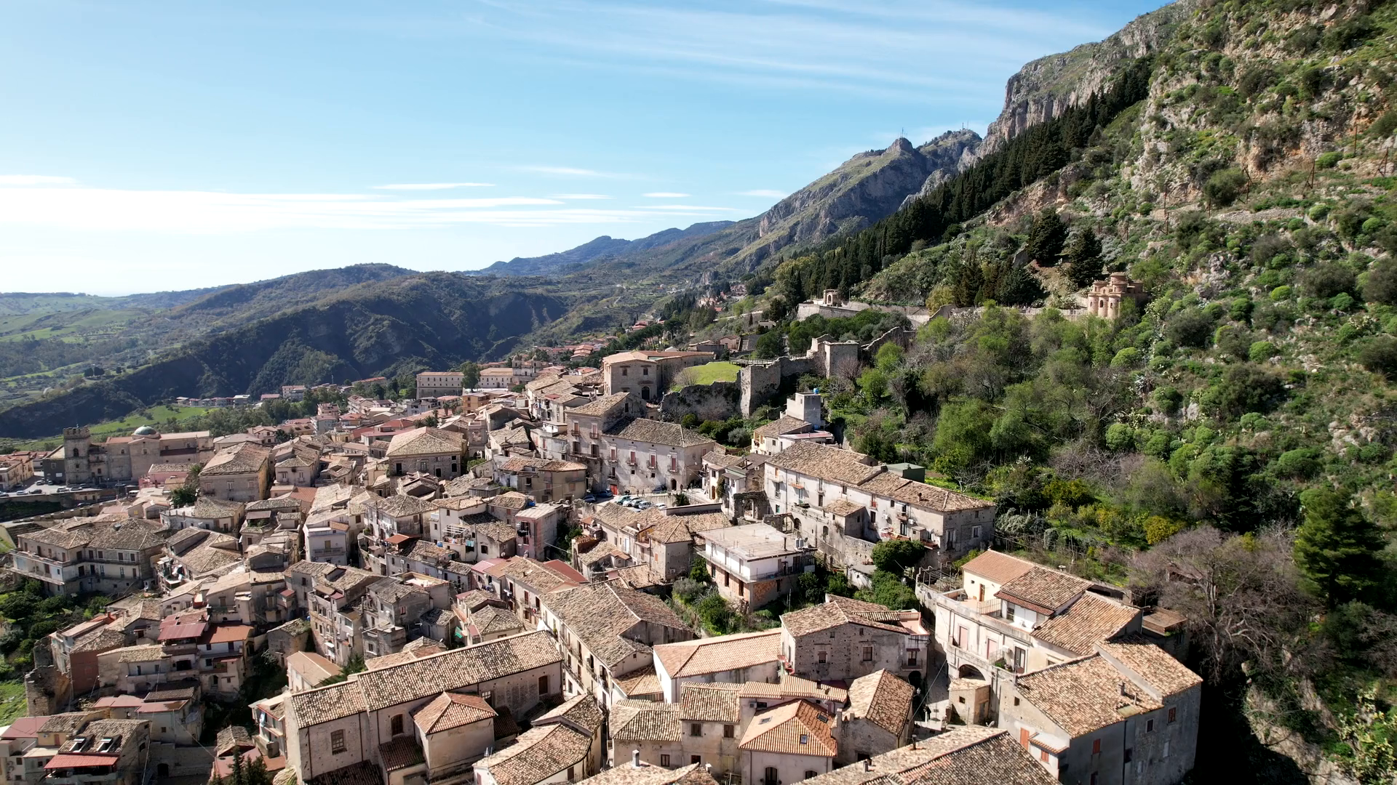
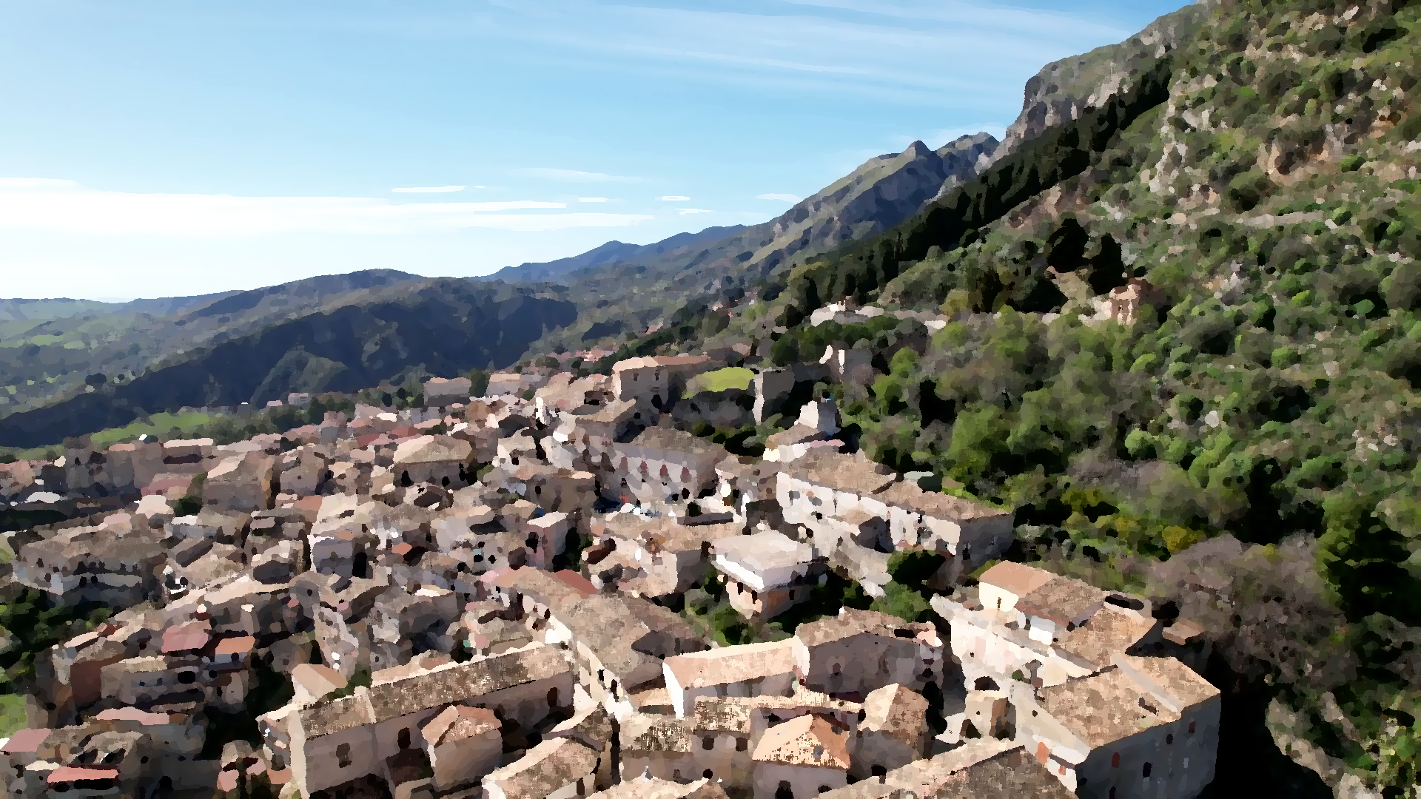
Visual Example — Before & After Oil Painting Filter

Slide 4
Oil Painting Filter Algorithm Overview
For each pixel:
-Examine neighborhood (radius = 4)
-Compute intensity histogram (20 levels)
-Find dominant intensity level in neighborhood
-Assign pixel the average color of dominant intensity group
Produces painterly, smooth effect

Slide 5
Sequential & Parallel Processing Overview
Sequential: Process frames one by one, pixel-by-pixel
Parallel: -Use Fork/Join framework
-Process frames in chunks with 1, 2, 4,
and 8 threads
-Recursive divide-and-conquer task splitting

Slide 6
Parallel Processing Design Details
Frames split into batches (~10 frames threshold)
ForkJoinPool manages thread pool and scheduling
Tasks invoke subtasks for balanced workload
Measures execution time for each thread count

Slide 7
Parallel Code Snippet
if (end - start <= THRESHOLD) {
// process frames directly
} else {
int mid = (start + end) / 2;
invokeAll(new FrameTask(...), new FrameTask(...));
}

Slide 8
Correctness Verification — JUnit Test
Pixel-by-pixel comparison between sequential and parallel outputs
Verifies exact image equality
Ensures no race conditions or artifacts

Slide 9
Sequential vs. Parallel Processing Results
Observation:
1 thread: Slightly worse due to overhead.
2 threads: Small improvement.
4 threads: Significant speed-up.
8 threads: Best performance.
Version | Threads | Time (sec) | Speed-Up
Sequential | 1 | 2447.42 | 1.00×
Parallel | 1 | 2580.45 | 0.95×
Parallel | 2 | 2187.17 | 1.12×
Parallel | 4 | 1361.35 | 1.80×
Parallel | 8 | 1110.90 | 2.20×

Slide 10
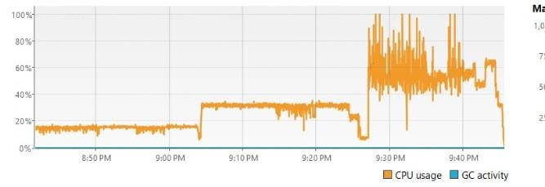
Sequential vs. Parallel Processing Results

Slide 11
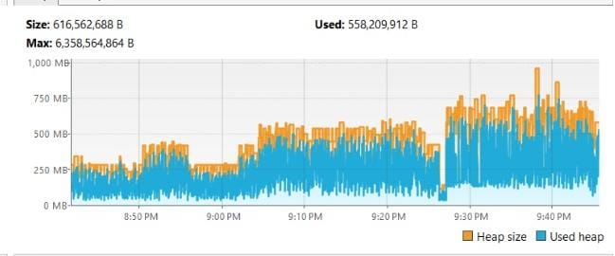
Sequential vs. Parallel Processing Results

Slide 12

Demo Preview — Original vs Oil Painting Video

Slide 13

Demo Preview — Original vs Oil Painting Video

Slide 14
Conclusion
From slow sequential to fast parallel
Correct, scalable, proven by tests & profiling
Strong speed-up on multi-core CPU
Clear path for further improvements

